Slide 1





Job Qualification Automation
Introduction to Robotic Process Automation
Reg No : 220701226 Name : RISHIKESH.T
Guide Name : Durai Murugan.N
Designation and department : Associate Professor Computer Science and Engineering

Slide 2
Abstract
In today’s competitive job market, automating candidate evaluation processes has become essential for improving efficiency and accuracy in recruitment workflows. This project presents a Job Qualification Automation System designed and implemented using UiPath Studio to streamline the evaluation of job applicants based on predefined criteria such as experience, skills, and education. The automation begins by reading candidate details from an Excel sheet and processing the data using UiPath's powerful DataTable operations. For each candidate, the system verifies qualifications against the job requirements, marking them as either "Qualified" or "Not Qualified" based on specific conditions. The results are dynamically updated in the candidate data sheet, ensuring transparency and traceability. Additionally, qualified candidates are notified via email, leveraging the Send SMTP Mail Message activity. Emails are customized to include personalized messages, enhancing communication and ensuring professionalism. The project incorporates error handling mechanisms to manage invalid or missing data, ensuring robustness and scalability for real-world applications.

Slide 3
Need for the Proposed System
The Job Qualification Automation project is designed to streamline the recruitment process by automating the evaluation of candidates against predefined job criteria. Built using UiPath Studio, this system reads candidate data from an Excel sheet, including details such as education, skills, experience, and email addresses. It evaluates each candidate’s qualifications by comparing their information with job-specific requirements, such as minimum years of experience, necessary skill sets, and education level.
Based on the evaluation, the system updates the Excel sheet with a "Qualified" or "Not Qualified" status for each candidate. For those who meet the criteria, the automation sends a personalized email notification using an SMTP server, informing them of their qualification. The workflow ensures efficiency, accuracy, and consistency in candidate screening, reducing manual effort and human errors. This project highlights the integration of robotic process automation (RPA) with email communication, demonstrating the power of automation in HR and recruitment workflows.

Slide 4
Advantages of the Proposed System
The proposed Job Qualification Automation System offers several
advantages, significantly enhancing the recruitment process. By automating candidate evaluation, the system ensures accuracy and consistency in screening against predefined job criteria, eliminating manual errors and reducing human bias. It saves substantial time and effort for HR teams by efficiently processing
large volumes of candidate data in seconds. The system’s ability to update qualification statuses in real-time and send personalized email notifications to qualified candidates streamlines communication and accelerates the hiring process. Additionally, it provides a scalable and cost-effective solution for organizations, ensuring reliable and data-driven decision-making in recruitment workflows.

Slide 5
Literature Survey
Paper 1:
Title: Automation of Candidate Screening Using RPA
Advantages:
Reduces human intervention in candidate evaluation.
Speeds up the recruitment process by processing large datasets efficiently.
Enhances accuracy by minimizing manual errors.
Allows integration with email systems for automated notifications.
Disadvantages:
Limited flexibility in handling highly subjective evaluation criteria.
Dependence on structured and well-maintained data inputs for reliable
outcomes.

Slide 6
Literature Survey
Paper 2:
Title: AI and Automation in HR: Transforming Recruitment Workflows
Advantages:
Demonstrates scalability for handling high-volume recruitment.
Improves data-driven decision-making through predefined job qualification
criteria.
Provides real-time updates and maintains consistency across candidate evaluations.
Disadvantages:
Initial setup requires significant time and resources.
May face challenges integrating with legacy systems or unstructured datasets.

Slide 7
Main Objective
The main objective of the Job Qualification Automation project is to streamline and optimize the recruitment process by leveraging Robotic Process Automation (RPA) to evaluate candidate profiles against predefined job criteria efficiently. This system aims to automate repetitive tasks such as data extraction, qualification checks, and result notifications, ensuring accuracy, consistency, and faster decision-making while reducing manual effort and improving overall productivity in the hiring process.

Slide 8
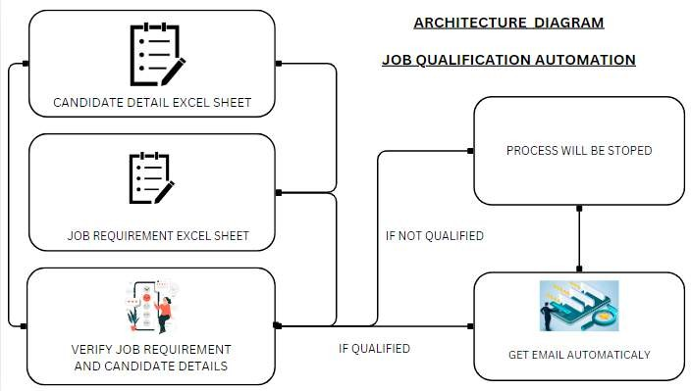
Architecture

Slide 9
System Requirements
UiPath Studio (Enterprise or Community Edition).
UiPath Robot (for unattended or attended automation).
SMTP/IMAP email server configured for sending notifications.
Excel/Spreadsheet Application:
Microsoft Excel (2016 or later) or equivalent software (Google Sheets, LibreOffice).
Other Software:
PDF reader for document processing (if candidate resumes are in PDF
format).
Browser (Chrome/Edge) for automation involving web-based job portals.

Slide 10
Functional Description
The job qualification automation system is designed to streamline the recruitment process by automating the evaluation of candidates based on predefined criteria such as skills, qualifications, and experience. The system ensures consistency, reduces manual effort, and speeds up decision-making.
The system evaluates the candidate’s qualifications against job-specific requirements
Skills: Matching candidate-provided skills with job requirements.
Experience: Calculating years of relevant experience.
Education: Verifying degree levels and fields of study.
.

Slide 11
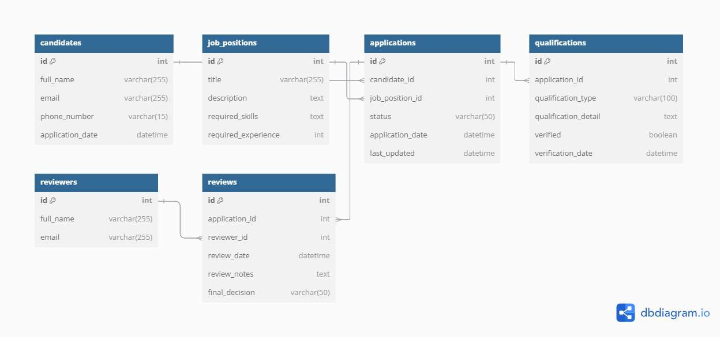
Table Design

Slide 12
Process Design
Main Process
The process begins when the user initiates the job qualification automation
workflow.
Retrieve candidate information (such as resumes and details) from the provided Excel sheet or directory.
Compare candidate qualifications with the predefined job criteria using
automated tools.
Record the evaluation status (Qualified/Not Qualified) in the Candidate Excel
file.
Automatically send emails to qualified candidates informing them of their status.

Slide 13
Process Design
Sub Process
Extract key information (e.g., education, skills, experience) from candidate resumes using automation.
Match extracted candidate details against job criteria, such as required education, experience, and skills.
Use the SMTP protocol to send emails to the candidates’ registered email
addresses.
Log any errors, such as missing data or email sending failures, for troubleshooting..

Slide 14
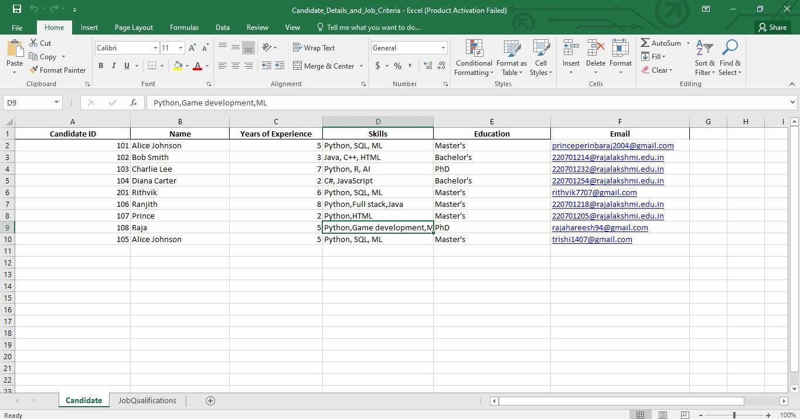
Implementation
Generate a Excel File will contain candidates detail

Slide 15
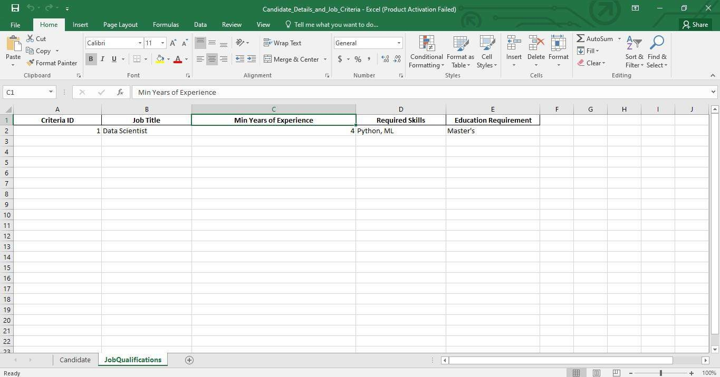
Implementation
Job Requirements Excel File

Slide 16
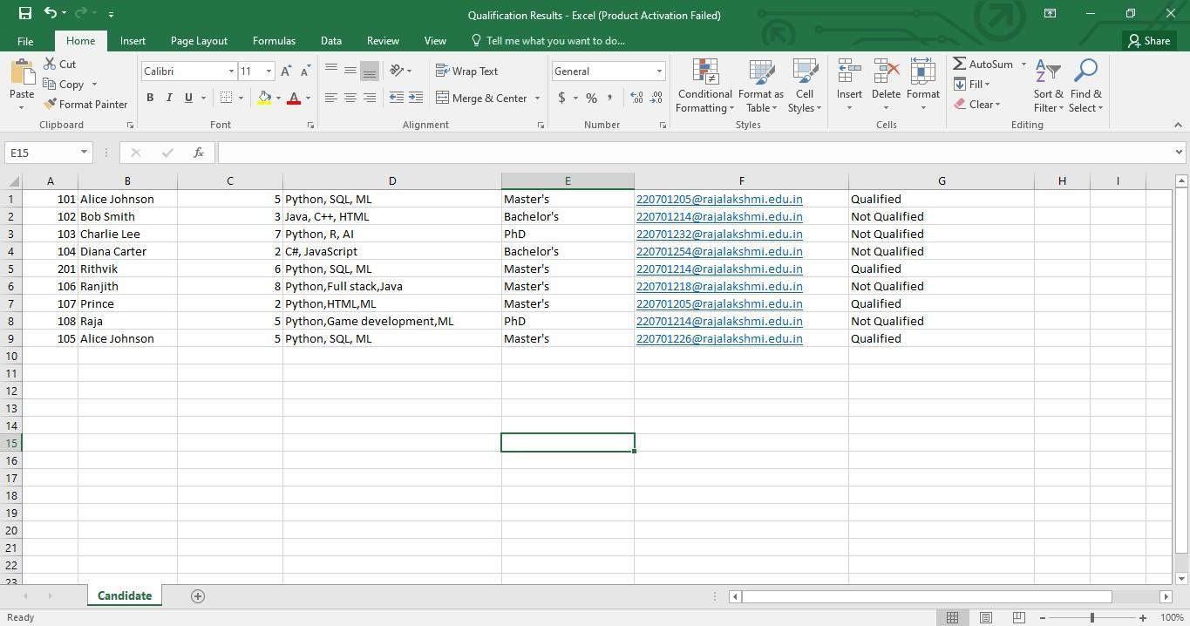
Implementation
After processing the Workflow Process Qualification Status Details Will Be Stored in The Excel File

Slide 17
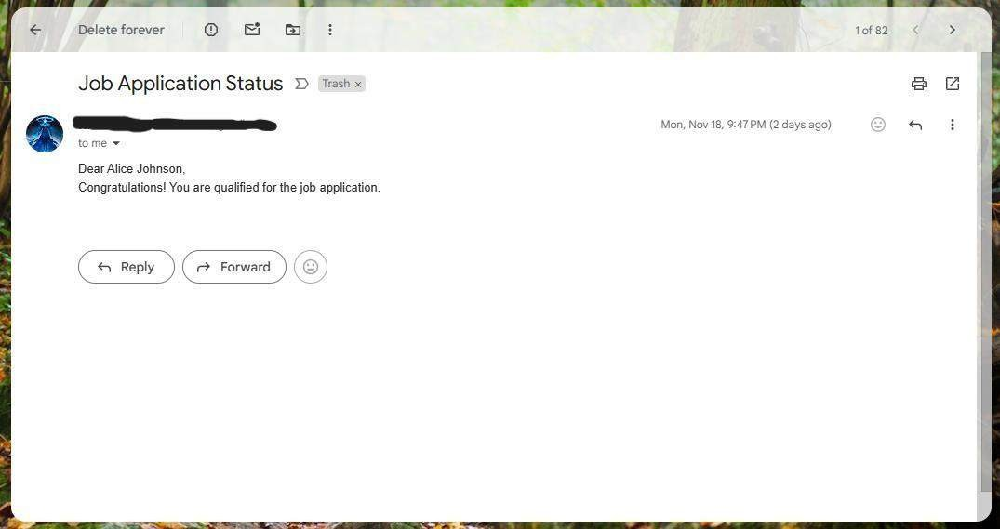
Implementation
If The Candidate Is Qualified They Will Receive The Email Notification.

Slide 18
Testing
UiPath Debugging Tools: For step-by-step workflow validation.
Excel Validation: To confirm accurate data updates in the candidate sheet.
SMTP Email Testing Tools: For verifying email functionality.
Exception Handling Logs: To track and fix errors

Slide 19
Conclusions
The Job Qualification Automation project successfully demonstrates the potential of automation technologies in streamlining the recruitment process. By integrating UiPath RPA, email services, and robust evaluation logic, this system efficiently processes candidate resumes, evaluates their qualifications, and sends personalized email notifications to eligible candidates. This approach not only saves significant time and resources for HR teams but also ensures accuracy and consistency in candidate evaluation.

Slide 20
Future Enhancement
Use AI to predict candidate suitability based on hiring trends and role requirements
. Let HR customize criteria weights for different roles (e.g., focus on technical skills or soft skills).
Add tools to analyze video interviews for speech, sentiment, and communication skills
Add a chatbot to guide candidates, answer questions, and provide updates.

Slide 21

Queries

Slide 22

Demonstration

Slide 23

Thank You

